Slide 1
Social Media Tech And How It Effects Modern Society
By: Nathaniel Martin

Slide 2
The Evolution of Social Media Technology
Social media grew quickly as new devices and tools appeared. This growth changed how people share information and stay connected around the world.
• Early platforms were simple
• Features expanded/ evolved over time
• More global accessibility

Slide 3


The Rise of Mobile Devices
Smartphones made social media a constant part of daily life. People no longer needed to wait to go online they could simply connect anywhere at anytime.
Easy photo and video sharing
Real-time posting and messaging
Continuous access throughout the day

Slide 4
Multi-Media Adaptation
Modern social media changed when platforms began focusing on photos, videos, and visual creativity. These tools made it easier for people to tell stories, share moments, and build their own online style.
High quality phone cameras made clear photos and videos easy
Editing tools let users add effects, music, and filters
Platforms like TikTok and Instagram built their entire design around visuals
Creative trends, challenges, and short videos became major parts of online culture

Slide 5
The Algorithm
Many people ask what is the algorithm? Algorithms make social media feel personal by curating each feed to its user, but they also create several issues that affect how people think and behave. These problems come from seeing the same type of content too often and becoming unaware of how much the platform influences daily life.
Content shown depends on past behavior
Users may see limited viewpoints
Online beliefs can be shaped without noticing

Slide 6
Artificial Intelligence (AI) in Social Media
Artificial intelligence helps social media run by checking posts, learning patterns, and managing large amounts of information. It makes platforms faster and safer, but it also brings concerns because it uses a lot of personal data. AI can be helpful, but it can also make mistakes, so people need to understand how it works.
Reviews large amounts of posts
Helps remove inappropriate content
Sometimes makes mistakes or misreads context

Slide 7
Evolution Positives
Through its continued growth and evolution, social media makes it easier for people to learn, connect, and grow. It supports communication across long distances and creates new chances for work.
Global connection
Business marketing and online stores
Skill building and shared knowledge

Slide 8
Evolution Dangers
Though I know we will continue to evolve our technology that doesn’t mean that it doesn’t come with its own new dangers. While helpful, social media also causes challenges for users. Too much time online can affect focus, mood, and personal privacy. Other negatives include:
Misinformation spreads quickly
Privacy concerns keep growing
Comparison can harm self-esteem
Online pressure affects young people

Slide 9
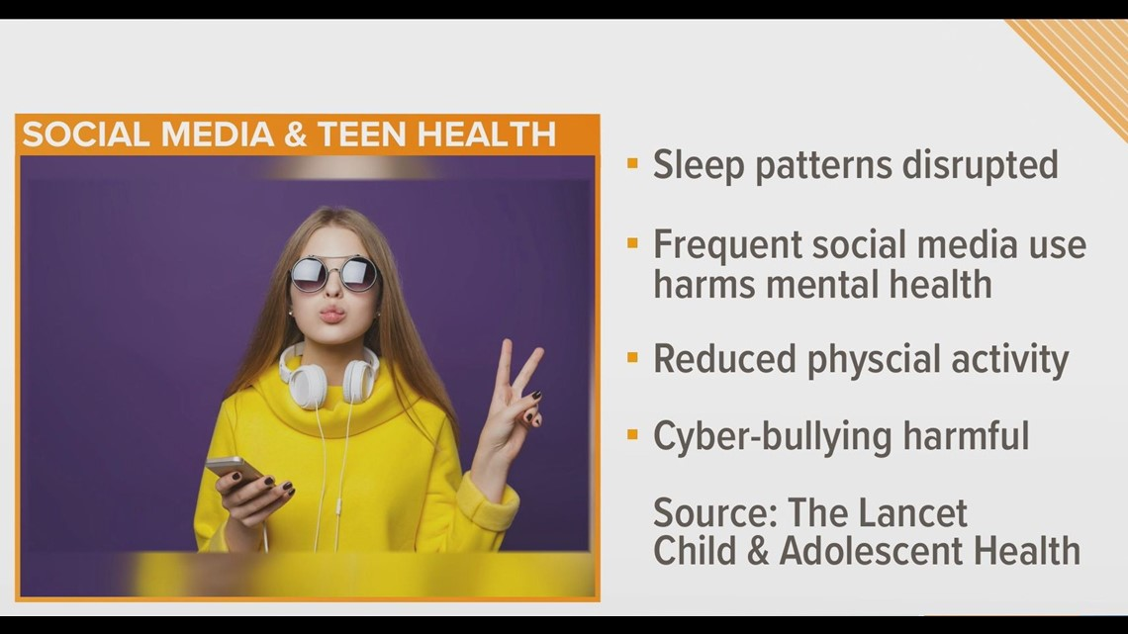
Mental Health Awareness
Researchers have shown us that teens face emotional pressure from social media on the daily. Constant alerts, online comparison, and digital noise can affect their very well-being. Other teen sightings included:
Stress from popularity expectations
Sleep disruption from long screen use
Mood changes according to online feedback

Slide 10
Global Accessibility
It’s a known fact that not everyone in the world has the same access to technology. This creates gaps in people’s ability to learn, get certain jobs, and even get access to basic digital opportunities.
Some countries have limited internet access
Uneven digital growth affects education
Fair use of data is still a major issue

Slide 11
World Issues
Social media will keep playing a major role in world events as technology grows. More people will use digital platforms to share information, organize movements, and respond to global challenges. This means social media will continue to shape how the world deals with crises, disagreements, and important decisions.
Online platforms will spread news about global problems faster
Activists will use social media to organize and raise awareness
Digital networks may influence political opinions and voting
Social platforms will continue to affect how people understand conflicts
False information may spread quickly during world events
Social media can help communities support each other during crises

Slide 12
The Future/ Impact of Social Media
Social media will continue to grow as technology improves, and its influence will reach every part of life. It brings people together and opens new opportunities, but it also creates challenges that need careful attention. Understanding how social media works helps people use it in a healthier and more responsible way.
Social media affects communication, culture, business, and global issues
New tools will make platforms even more powerful
Users must stay aware of privacy, safety, and online behavior
Digital education will become more important for future generations
Balancing benefits and risks will shape the future of social platforms

Slide 13
References
DataReportal. “Social Media Users.” DataReportal, https://datareportal.com/social-media-users.
Kelly, Robert, et al. “Algorithmic Systems and User Behavior.” National Library of Medicine, United States National Institutes of Health, https://pmc.ncbi.nlm.nih.gov/articles/PMC11373151.
World Health Organization. “Teens, Screens, and Mental Health.” World Health Organization Europe, https://www.who.int/europe/news/item/25-09-2024-teens--screens-and-mental-health
United Nations. “The Impact of Digital Technologies.” UN75, United Nations, https://www.un.org/en/un75/impact-digital-technologies.

